Slide 1
Chemistry – Feb 5, 2020
P3 Challenge –
A)What is the electron configuration for Phosphorus?
B) How many valence electrons for P?
Objective –
Chemical Bonding
Assignment:
Chemical Bonding Worksheet
Study for Polyatomic ion practice quiz on Friday
Agenda
Practice Polyatomic ion quiz
Valence Electrons
Octet Rule
Lewis Structures
Predicting Compounds
Ionic vs Covalent bonding
Polarity

Slide 2
Valence Electrons
Valence electrons located in s and p orbitals with the highest principle quantum number. All other electrons are core electrons.
Varies from 1 to 8 with a completed octet most stable
Octet Rule: Atoms tend to complete an octet so their outer shell looks like a noble gas.
Done by losing or gaining the fewest electrons

Slide 3
Compound formation
Recall that a compound is a pure substance composed of two or more elements.
Similarly a compound is a combination of two or more types of atoms.
Compounds form in order to follow the octet rule for all atoms.
Three strategies are possible,
Ionic compounds TRANSFER electrons using ionic bonds
Covalent compounds SHARE electrons using covalent bonds
Metals pool their valence electrons together

Slide 4
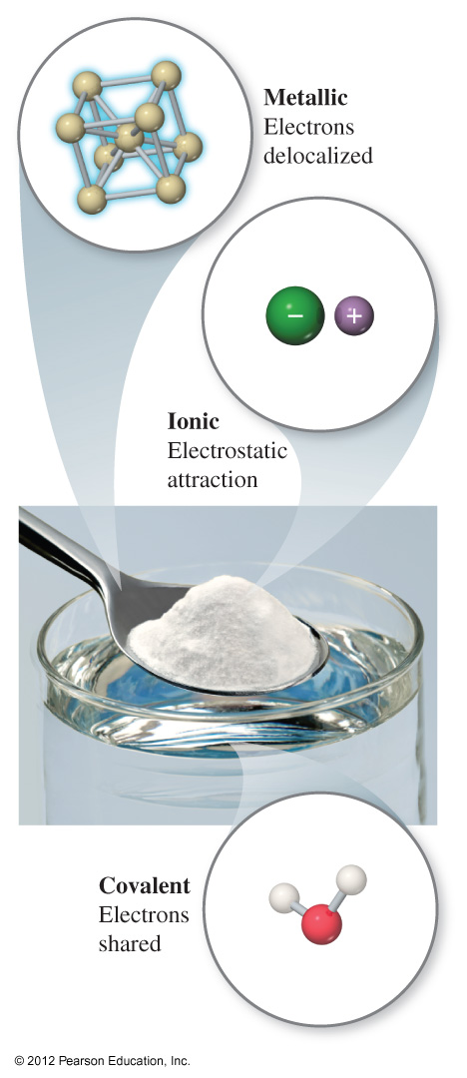
Three Types of Chemical Bonding
Ionic Bonding: Transfer of electrons
Commonly between a metal and a nonmetal.
Usually completes valance octets for both atoms.
Covalent Bonding: Sharing of electrons
Commonly between two nonmetals.
Usually completes valance octets for both atoms.
Metal Bonding: Pooling of electrons
Commonly between metals.
Exists as a sea of electrons around a lattice of metal ions

Slide 5
Lewis Structure Basics
Lewis structures show HOW atoms transfer or share electrons.
Lewis structures are representations showing all valence electrons, bonding and nonbonding.
Atomic symbols represent nuclei.
Bonding electrons shown as a line connecting nuclei. Each line represents 2 electrons.
Nonbonding electrons shown individually as dots in 8 possible locations.
Hydrogen doesn’t follow the octet rule. H is complete with only 2 electrons.

Slide 6
Drawing Ionic Lewis Diagrams
Ex: Draw the atomic Lewis diagram and ionic Lewis diagram for K, Ca, Br and S.
Ex: Use Lewis diagrams to demonstrate compound formation for:
K and Br
K and S
Ca and Br

Slide 7
Bond Polarity and types of bonds
Bond polarity is an indication of how much sharing or transfer of electrons is present.
Based on electronegativity differences.
Three types of bonds: Ionic, nonpolar (pure covalent), polar covalent
Ionic transfer of electrons large electronegativity difference
Nonpolar share electrons equally no electronegativity difference
Polar Covalent share electrons unequally small electronegativity difference

Slide 8
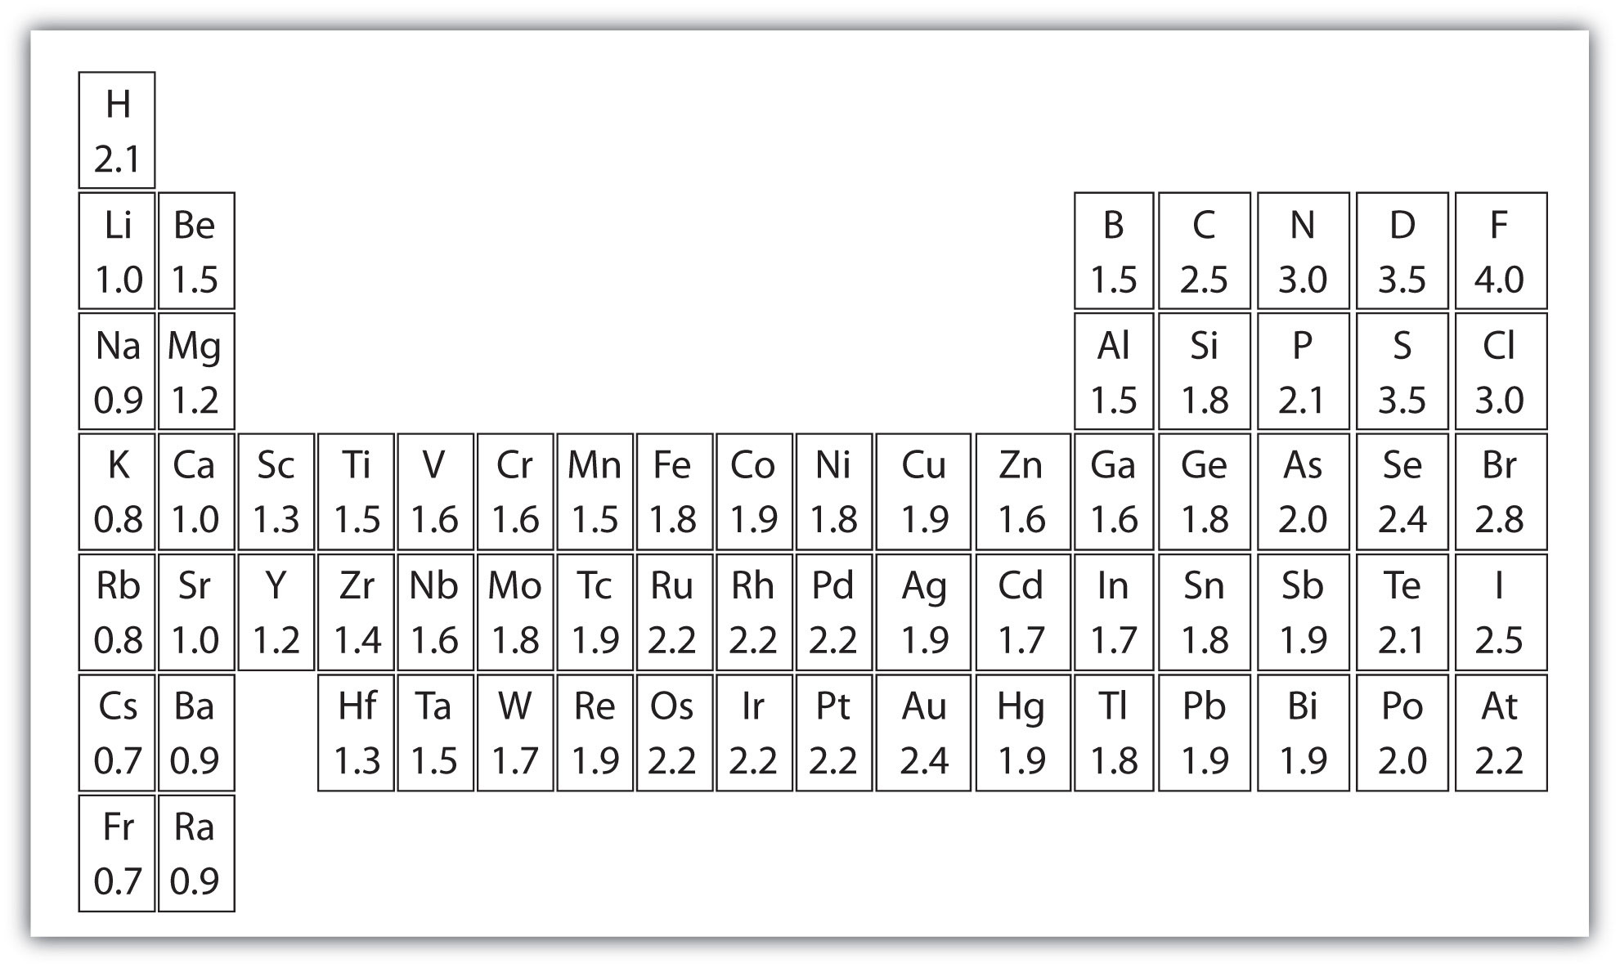
Electronegativity Review
Electronegativity is the ability of atoms in a molecule to attract electrons to themselves.
On the periodic chart, electronegativity increases as you go…
…from left to right
…from the bottom to the top
Note the most electronegative element F.
Undefined for Noble Gases

Slide 9
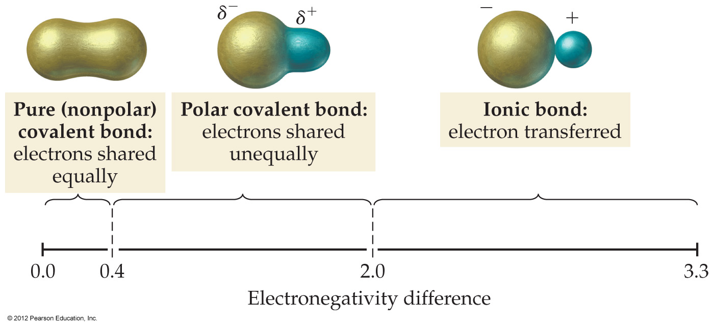
Differentiating Ionic and Covalent Bonds
Find the difference in electronegativity between the two atoms involved in a bond.

Slide 10
Identifying Bond Types
Determine the type of bond that forms between:
C and Br
K and F
P and O
N and N

Slide 11
Exit Slip - Homework
Exit Slip: Rank the following bonds from least to greatest polarity:
NaCl, CS₂, H₂O, NH₃
What’s Due? (Pending assignments to complete.)
Complete the Chemical Bonding Worksheet
Study for Real Polyatomic ion quiz on Friday
What’s Next? (How to prepare for the next day)
Read p194-198

